Slide 1
Laws related to ICT
Prof Koliya pulasinghe

Slide 2
Introduction
Introduction to Sri Lankan Legal Systems
ICT Related Acts
Evidence (Special Provisions) Act, No 14 of 1995
Intellectual Property Act, No 36 of 2003
Electronic Transactions Act, No 19 of 2006
Payment Devices Frauds Act, No. 30 of 2006
Computer Crimes Act, No 24 of 2007
Summary

Slide 3
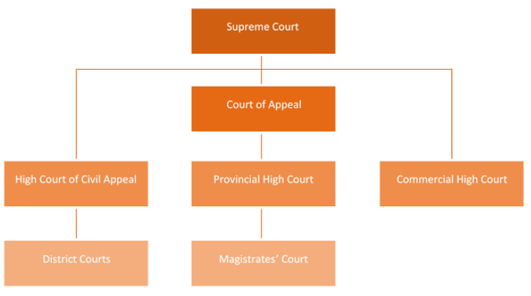
Introduction to SL Legal System
Executive Presidency, Judiciary, Legislature
Laws are enacted by Legislature
Criminal offences such as rape, murder, sexual abuse are handled by a Magistrates’ courts results in fine or jail term
Civil cases are handled by District courts cover almost all other disputes, and typically aim for some sort of recovery or compensation

Slide 4
ICT related Acts:
Evidence (Special Provisions) Act, No 14 of 1995
Intellectual Property Act, No 36 of 2003
Electronic Transactions Act, No 19 of 2006
Payment Devices Frauds Act, No. 30 of 2006
Computer Crimes Act, No 24 of 2007

Slide 5
Evidence (Special Provisions) Act No. 14 of 1995
Provides for
(a)the admissibility of any contemporaneous recording made by electronic means and
(b)facts and information contained in a statement produced by a computer
Admissibility under this Act is subject to several conditions – that the computer producing the statement was operating properly, Information supplied to the Computer was accurate etc

Slide 6
Intellectual Property Act, No 36 of 2003
Computer Programs are protected under Intellectual works protected under the act
Under the economic rights: “owner of copyright of a work shall have the exclusive right to carry out or to authorize the following acts in relation to the work”
Under the act, Private reproduction of a published work in a single copy shall be permitted;
Any person has access to a computer program infringing the rights of another person, and wilfully makes use of such program for commercial gain, shall be guilty of an offence and shall be liable on conviction by a Magistrate for a fine not exceeding rupees five hundred thousand or to imprisonment for a period of six months or to both such fine and imprisonment.

Slide 7
Electronic Transactions Act, No 19 of 2006
AN Act TO RECOGNISE AND FACILITATE THE FORMATION OF CONTRACTS, THE CREATION AND EXCHANGE OF DATA MESSAGES, ELECTRONIC DOCUMENTS, ELECTRONIC RECORDS AND OTHER COMMUNICATIONS IN ELECTRONIC FORM IN SRI LANKA
All transactions and business done in “electronic” form would be recognized under the Act, except those specifically excluded under Section 23 (Last Wills, Power of Attorney, Transfer of immovable Property etc)

Slide 8
Electronic Transactions Act, No 19 of 2006
Section 4 -Electronic equivalent of “Writing” - “Functional equivalence” principle
Section 5 & 6: Maintaining originality and Retention in Electronic Form
Section 8: Facilitates e Government
Section 11 to 17: Electronic Contracts

Slide 9
Electronic Transactions Act, No 19 of 2006
Section 7: Legal Validity of Electronic Signatures
Method used is proven in fact to have fulfilled the functions of identifying the party and proving the party’s intention in respect of the information contained in the message, by itself or together with further evidence
method is as reliable as appropriate for the purpose for which the electronic communication was generated or communicated in the light of all the circumstances, including any relevant agreement;
Any technology is acceptable - PIN No, QR Codes, Biometrics, Scanned signature etc.
Digital Certificates issued by “Certificate Service Provider” ensures Legal validity

Slide 10
Payment Devices Frauds Act, No. 30 of 2006
Aims of the act:
To prevent the possession and use of unauthorised or counterfeit payment devices
To create offences connected with the possession or use of unauthorised payment devices
To protect persons lawfully issuing and using such payment devices
To make provision for the investigation, prosecution and punishment of offenders

Slide 11
Payment Devices Frauds Act, No. 30 of 2006
A person guilty of an offence under this Act shall, on conviction after trial before the High Court:
In severe cases (as mentioned in item a. to j.) be liable to a term of imprisonment not exceeding ten years or to a fine not exceeding rupees five hundred thousand or to both such imprisonment and fine
In not so severe cases (item m. to p.) be liable to a term of imprisonment not exceeding three years or to a fine not exceeding one hundred thousand rupees or to a fine which may extend to five times the value of the money obtained by the commission of the act

Slide 12
Computer Crimes Act, No 24 of 2007
Aims of the act:
To provide for the identification of computer crime
To provide the procedure for the investigation and prevention of such crimes
To provide for matters connected therewith and incidental thereto.

Slide 13

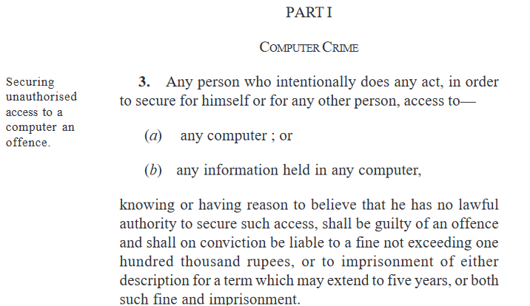




Computer Crime

Slide 14
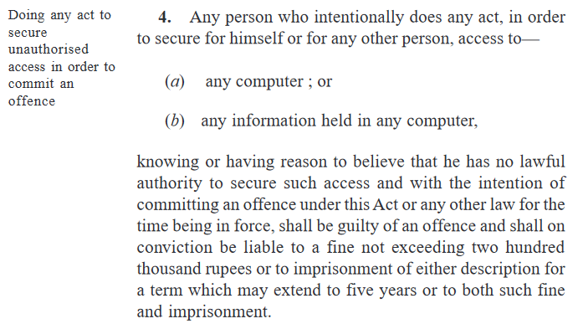

Computer Crime

Slide 15
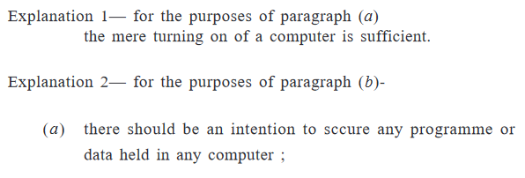

Slide 16
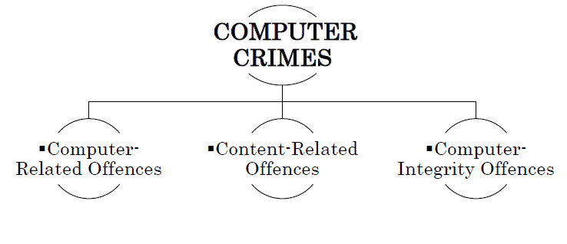


Slide 17
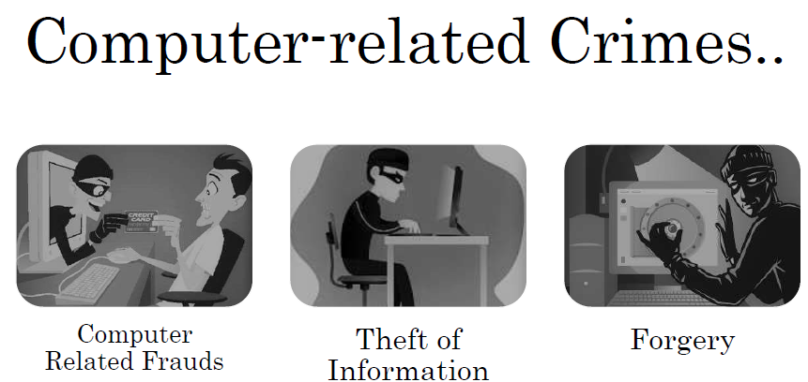

Slide 18
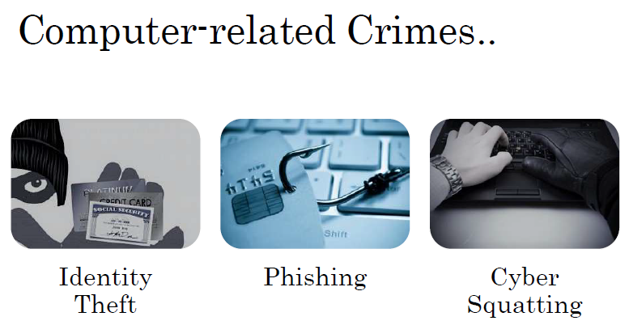

Slide 19
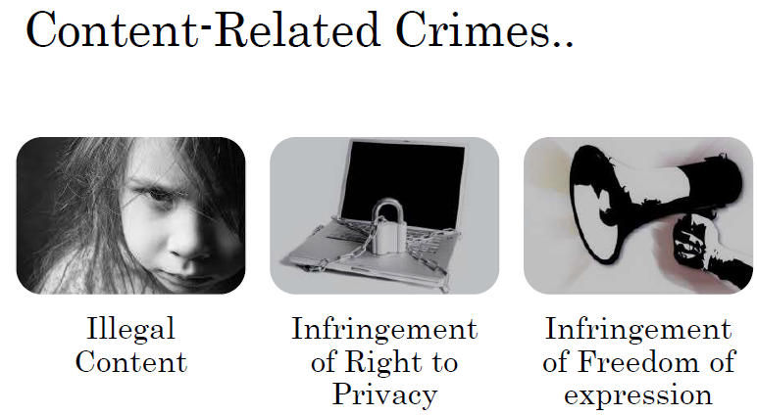

Slide 20
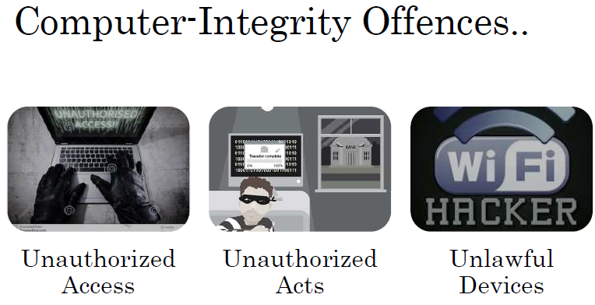

Slide 21
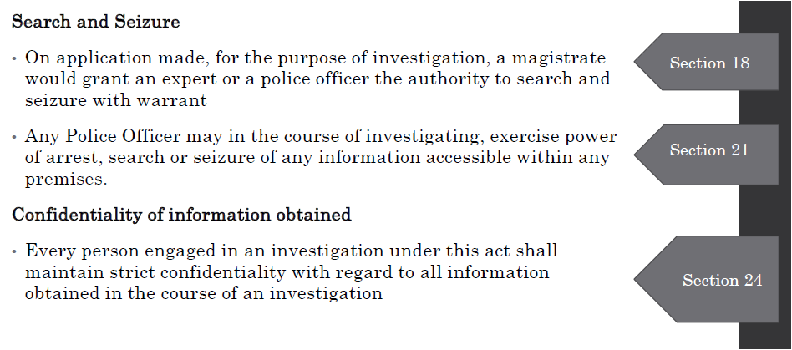

Slide 22
Summary
All these Laws have been enacted to have safe environment for computer use by general public to various activities in day today life without fear
And punish those who do wrongful acts
Professionals in ICT area must be thorough with these Laws to engage in their professional practice

Slide 23
Assignment
Task 1: Find out four cases reported in media that come under the purview of these Acts of Law. Write short description (200 words max) about each.
Task 2: Reflect on impact of above Laws on your professional career. Write down your own rules for your professional life.
Submit PDF of your assignment on or before 25th May, 2021 mid night.

